Slide 1
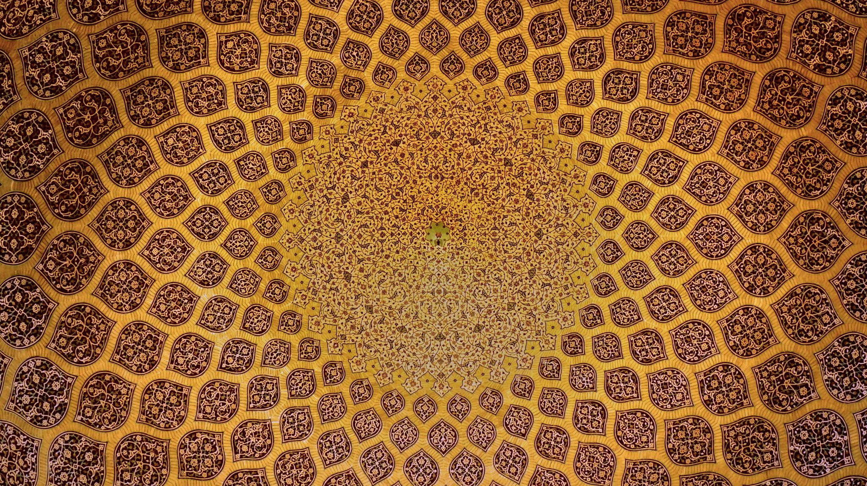
Design Patterns in C#
By: Saul Varshavsky

Slide 2
Creational Design Patterns
What are ways in which objects can be created?

Slide 3
Prototype Pattern
Allows existing objects to be copied or cloned when new ones get created
Ensures the new objects DON’T depend directly on the existing objects
Application for duplicating various shapes
Let’s say there is a “ShapeActions” object that takes care of the duplication process for the shape objects (e.g. “Circle”, “Rectangle”, etc.)
With this approach, the Single Responsibility Principle and Open-Closed Principle get violated
Solution:
Create a “Shape” interface that the shape objects will instead depend on
The “duplicate()” method from the interface can then be implemented by the shape objects themselves
ShapeActions
duplicate():
Shape (interface)
draw();
duplicate():
ShapeActions
duplicate():
Circle
draw():
Rectangle
draw():
Circle
draw():
duplicate():
Rectangle
draw():
duplicate():

Slide 4
Singleton Pattern
Ensures that a given object could be instantiated ONLY once and further provide global access for using that object
Application containing one large database used across many features
Let’s say there is a “Database” object that represents the database
Both the “UserAuthentication” and “ProductPurchase” objects rely on the “Database” object for retrieving the necessary data
With this approach, the “Database” object would have to be instantiated for every single object (e.g. “UserAuthentication”, “ProductPurchase”, etc.) that uses it
Solution:
The “Database” object will contain a method called “getInstance()” to create the actual object that the other objects will instead depend on
From there, the objects relying on the “Database” object can utilize that method without having to constantly create a new instance and take up RAM
Database
Database
getInstance():
UserAuthentication
retrieveData():
ProductPurchase
retrieveData():
UserAuthentication
retrieveData():
ProductPurchase
retrieveData():

Slide 5
Factory Method Pattern
Defines an interface for creating an object using a superclass, with the subclass(es) deciding on the exact object to create
Application for rendering various design templates
The “Controller” interface would represent the superclass, specifying the ability to render a design template
“DesignControllerOne”, “DesignControllerTwo”, etc. would represent the subclasses that specify the exact templates that should be rendered
This approach adheres well to the Liskov Substitution Principle
Controller (interface)
render():
DesignControllerOne
render():
DesignControllerTwo
render():

Slide 6
Abstract Factory Pattern
Defines an interface for creating families of related objects without specifying each of the individual objects comprising a given family
Application for using various UI components across different operating systems
Let’s assume the behaviors of the components are the same, regardless of the operating system
Because of consistent behaviors, we don’t need to define all of these components separately
Even though they may slightly differ in look, their functionality is the same
Therefore, the different look of the UI components can easily be grouped by operating system
UIComponentFactory (interface)
createPage():
MacComponentFactory
createPage():
WindowsComponentFactory
createPage():

Slide 7
Builder Pattern
Useful when designing complex objects through a series of steps
Application containing a car that has many parts to it
Let’s say there is a “Car” object that contains numerous objects that make it up (e.g. “Engine”, “Wheels”, “Dashboard”, etc.)
Because all these objects come into play and must be passed into the constructor, it can make it challenging to maintain the code
Violates the Open-Closed Principle and Dependency Inversion Principle
Solution:
The “CarBuilder” object specifies all the steps needed to make the car
The objects that make up the car can then reference any or all of these steps, ensuring that none of these objects have to be passed inside the constructor of the “Car” object
Builder (interface)
buildEngine():
buildWheels():
buildDashboard():
CarBuilder
buildEngine():
buildWheels():
buildDashboard():
Car
create():
Car
buildCar():
Engine
Wheels
Dashboard
Engine
buildEngine():
Wheels
buildWheels():
Dashboard
buildDashboard():

Slide 8
Structural Design Patterns
What are ways in which objects can be related?

Slide 9
Composite Pattern
Collections of individual objects get represented with a “tree” structure
Application for determining the total price of an Amazon package
A package could contain multiple boxes
Boxes can contain the actual items delivered, or contain smaller boxes which may then have items in them
Representative of a “tree” structure
The entire package is the Root Node
The boxes are the other Nodes
Package
Item (interface)
getPrice():
Box
Box
Box
getPrice():
Product
getPrice():
Laptop
Box
Box
Mouse
Keyboard

Slide 10
Adapter Pattern
Ensures objects with incompatible interfaces with other objects can still be used by those other objects
Application for selecting the color of the video the user uploads (e.g. black/white, colored, color-blind friendly, etc.)
The “Color” interface contains the methods used for specifying the color of the uploaded video
However, let’s say a third-party package gets introduced called “Rainbow”, specifically for making the uploaded video color-blind friendly
Incompatible with the “Color” interface because of different methods
Would violate the Interface Segregation Principle
Solution:
Create a separate class (e.g. “RainbowColor”) for using the “Rainbow” package in AT LEAST ONE of the methods from the “Color” interface
Color (interface)
applyColor():
RainbowColor
applyColor():
VideoEditor
applyColor():

Slide 11
Bridge Pattern
The “bridge” is a way to connect two major “tree” structures, or hierarchies, together
Application where multiple remote controls are used to control a given technology, such as radios
One “tree” would represent the different remote controls used to control a radio
Another “tree” would represent the specific brands radios, such as their brands
The “bridge” would represent a composition relationship, since a “RemoteControl” HAS A “Device” that it controls
One of the root nodes acts as an Abstract Class, whereas another one acts as an Interface
Since the radios pretty much function in the same way across brands, it makes more sense to treat the root node of that tree as an interface; whereas remote controls each have different functionalities, making it more sense for the root node of that tree to be an abstract class
RemoteControl (abstract class)
turnOnOff():
Radio (interface)
turnOnOff():
MusicRemote
turnOnOff():
selectSong();
NewsRemote
turnOnOff():
selectNews();
LGRadio
turnOnOff():
SonyRadio
turnOnOff():

Slide 12
Proxy Pattern
There exists a “proxy” objects that controls access between multiple objects
Application for fetching a list of YouTube videos from YouTube’s API
The “YouTubeVideo” class renders the appropriate videos that are being fetched from the YouTube API
The “VideoProxy” class servers as the “proxy”, ensuring the user ONLY access the videos that are rendered
The “VideoList” class stores the rendered videos
VideoList
addVideo():
Video (interface)
render():
YouTubeVideo
render():
VideoProxy
render():

Slide 13
Flyweight Pattern
Rather than represent individual objects, it uses the common attributes across these objects as one object
In essence, one object is used to simplify the creation of many objects, saving RAM usage
Application keeping track of all the crops on a large farm
If each “Crop” were to represent an individual object, there would be way too many objects to keep track of in the application
Solution:
An object can represent the type of crop being planted (e.g. potatoes, carrots, etc.)
Ensures the Open-Closed Principle is not violated
Crop
location():
CropIcon
type():
icon():
Crop
type():
icon():
location():
CropIconFactory
getIcon(type):
CropService
getCrop():

Slide 14
Facade Pattern
Used for encapsulating all the complexities the user shouldn’t have to worry about when using an application
Application for submitting a fast food order
A series of steps have to be completed to submit an order
Some of these steps involve authenticating the user, checking the available inventory, connecting the payment method, etc. – none of which the user should have to worry about
All the user cares about is placing an order and then getting their food
The “OrderService” class is where the order gets completed
depends on classes representing the specific steps that need to be taken to a place an order the user shouldn’t worry about
OrderService
order(request):
OrderFulfillment
fulfillOrder():
Authenticate
authenticate():
Inventory
checkInventory():
Payment
connectPayment():

Slide 15
Decorator Pattern
Enables the ability to add new behavior to an object without having to actually modify the object
Application for storing data in a cloud
Data can be stored in various ways: being directly sent to the cloud, encrypted before being stored, etc.
It later gets decided that before the data can be stored in the cloud, it has to be cleaned
Instead of modifying the object responsible for storing data in the cloud, a new one can get created
The “DataDecorator” class will override the “save” method from the “Data” interface, so that the data now gets cleaned before being passed to the “CloudData” object for being stored in the cloud
CloudData
save(data):
Data (interface)
save(data):
DataDecorator
save(data):

Slide 16
Behavioral Design Patterns
What are ways in which objects can interact?

Slide 17
Memento Pattern
Used to restore an object to its previous state without revealing its implementation details
Application for modifying a word document
The “Editor” class used to edit the textual content of the document
The “PrevContent” attribute stores a list of all the content that was previously edited up till now
This is problematic, because this attribute (and class as a whole) has no way to keep track of the exact edits the user made to result in the content changes
The “EditorState” class is made to keep track of those exact edits
Violates the Single Responsibility Principle, as the “EditorState” has to keep track of multiple responsibilities – keeping track of the current AS WELL AS previous content changes
Solution:
The “History” class keeps track ONLY of the previous content changes, whereas the “Editor” class ONLY keeps track of the content right now by grabbing the most up-to-date content changes from the “EditorState” class
Editor
content: string
createState():
restore(state):
EditorState
content: string
Editor
content: string
prevContent: list
History
states: list
editor: editor
backup():
undo():
Editor
content: string
prevStates: list
EditorState
content: string

Slide 18
State Pattern
Enables the ability for an object to take on different behaviors when changes are made to them
Think of it as an object taking on the roles of other objects depending on the behaviors it needs to perform
Application for writing blog posts
A blog post can be in either 1 of 3 states: Draft, Moderation, or Published
The “Document” class stores the current state of the blog post, with each state being representative as an individual class
The user can be in either 1 of 3 roles: Reader, Editor, and Admin
The user role will be used to decide on the current state of the blog post
For example, if the user has a role of “Admin”, then they’re able to publish the blog post
State (interface)
workBlog():
Document
determineState(state):
blogContext(state):
DraftState
workBlog():
ModerationState
workBlog():
PublishedState
workBlog():

Slide 19
Strategy Pattern
Used to pass behaviors of various objects onto a single object, where the behaviors passed are separate from the behaviors defined inside those objects
Think of it as an object taking on the roles of other objects depending on the behaviors it needs to perform
Application for storing video files
In order for a video file to be stored, it needs to be compressed into a MOV, MP4, etc. type of file, as well as overlayed
The “VideoStorage” class stores a given video based on the way it was compressed and overlayed
In essence, the “VideoStorage” class determines what kind of behaviors a given video should have (e.g. the type of compression, the way it’s overlayed, etc.)
The specific “compressor” and “overlay” classes define the behaviors that get passed to the “VideoStorage” class
CompressorMP4
compress():
VideoStorage
compressor:
overlay:
storageState():
Compressor (interface)
compress():
CompressorMOV
compress():
Overlay (interface)
apply():
OverlayBlur
apply():

Slide 20
Iterator Pattern
Used to iterate over an object without having to expose its internal structure
Application for grocery shopping
The “ShoppingList” class adds or removes a grocery item to a list
An iterator class is used to iterate through the list of grocery items, without needing it to be modified
Adheres to the Single Responsibility Principle by ensuring the “ShoppingList” class is ONLY responsible for managing a single grocery item, whereas the iterator class is ONLY responsible for managing the list of grocery items
ShoppingList
push(item):
pop():
createIterator():
Iterator (interface)
next():
current():
has():
ListIterator
next():
current():
has():

Slide 21
Command Pattern
Used for encapsulating a certain request or action the user doesn’t need to know as a separate object
Application for using a remote control to turn the light on and off
The “Light” class turns the light on and off
The “RemoteControl” class commands the “Light” object to either turn the light on or off
This creates high coupling though, as the “RemoteControl” class directly depends on the “Light” class
If a new method such as “dim():” were to be added to the “Light” class, it would mean the “RemoteControl” class would also need to be modified – this violates the Open-Closed Principle
Solution:
The “RemoteControl” class will instead depend on the “Command” interface, which keeps track of a possible actions of the remote control
Each of the actions will be separate objects (i.e. the actions will be encapsulated) that are concrete implementation of the “Command” interface
RemoteControl
Command:
pressButton():
Command (interface)
execute():
Light
turnOn():
turnOff():
RemoteControl
pressButton():
Light
turnOn():
turnOff():
TurnOn
Light:
execute:
TurnOff
Light:
execute:

Slide 22
Template Method Pattern
An abstract or parent class defines a template of behaviors that can then be shared across sub or child classes
Application specifying the steps to make various beverages, such as tea, coffee, chamomile, etc.
It’s not a good approach to create objects that each represent beverages (e.g. “Coffee”, “Tea”, “Chamomile”, etc.)
Incredibly inefficient, as some steps may be completely identical (e.g. boiling water, pouring beverage into cup, etc.) and it’s time consuming to write steps on how to make the beverage for every single class
Solution:
An abstract class called “Beverage” will specify the steps that are identical across all beverages, allowing them to be inherited by the sub classes
Beverage (abstract class)
prepare():
brew():
addCondiments():
Tea
brew():
addCondiments():
Coffee
brew():
addCondiments():
Chamomile
brew():

Slide 23
Observer Pattern
An object known as the subject keeps track of and maintains other objects known as the observers
Application for managing multiple spreadsheet in an Excel file
The spreadsheets could be modeled as the observer objects that are part of the Excel file object, which therefore could be modeled as the subject class
The Excel file ultimately keeps track of the edits and content of the spreadsheets
File (abstract class)
addSheet():
removeSheet():
notifySheets():
Observer (interface)
update():
ExcelFile
addSheet():
removeSheet()
Sheet1
update():
Sheet2
update():

Slide 24
Mediator Pattern
Allows multiple objects to interact with each other without them having access to each other’s information
A meditator object facilitates the interaction between these objects
Application for a blog containing various posts
There exist 3 different states with the posts:
No post gets selected to be edited, a post gets selected to be edited and able to be saved, a post gets selected to be edited with saving it being disabled (i.e. missing required information on the post)
The editing and saving actions constantly must interact with each other to determine the appropriate state
Those actions can be modeled as separate objects
The “DialogBox” abstract class will serve as the mediator, enabling the ability for all the necessary actions used for determining the 3 states to interact with each – while encapsulating the internal structures of those actions by having them defined as objects
EditPost
edit():
DialogBox (abstract class)
getState():
changeState():
SavePost
save():
PostDialogBox (abstract class)
getState():
changeState():

Slide 25
Chain of Responsibility Pattern
Involves building a chain of objects that are each responsible for handling requests in a specific order
Application for where only admins are able to access certain webpages
To ensure one is an admin, their information needs to be validated, then authenticated, and finally they need to log in
Each of those steps for ensuring one is an admin can be modeled as objects
Once the request to validate the user has been fulfilled, the request for the user to be authenticated has to be fulfilled, and so on
WebServer
handle(request):
Handler (abstract class)
nextStep(Handler):
handle(request):
Validator
handle(request):
Authenticator
handle(request):
Logger
handle(request):

Slide 26
Visitor Pattern
Used to separate object behaviors from the actual objects these behaviors need to be applied to
Application that a marketing agency uses to keep track of various clients, such as restaurants, law firms, retailers, etc.
Important to send specialized emails appropriate to the specific clients
However, it’s problematic to include a method for sending a specialized email for each of the client classes
Results in the behavior of sending a specialized email as part of the actual object
Solution:
The “EmailVisitor” class will be dedicated specifically for sending a specialized email to the appropriate client
Allows object behaviors to be applied as needed, without using the objects themselves
Client (abstract class)
name:
email:
getEmail():
accept(Visitor):
Visitor (interface)
sendRestaurant():
sendLawFirm():
sendRetailer():
EmailVisitor
sendRestaurant():
sendLawFirm():
sendRetailer():
Restaurant
accept(Visitor):
LawFirm
accept(Visitor):
Retailer
accept(Visitor):

Slide 27
Interpreter Pattern
Involves parsing user input into a “Expression Tree” structure for performing calculation
Not used very often and very specific to applications involved calculating something
Think of the “Expression Tree” as a hierarchy of objects representing the calculation rules that need to be performed in a given order (e.g. PEMDAS)
Application for creating a calculator
The “TerminalExpressions” class keeps track of operators
The “NonTerminalExpressions” class keeps track of integers
Expression (interface)
interpret(Context):
Client
TerminalExpression
interpret(Context):
NonTerminalExpression
interpret(Context):

